Slide 1
Information Security
Richard's Session!

Slide 2
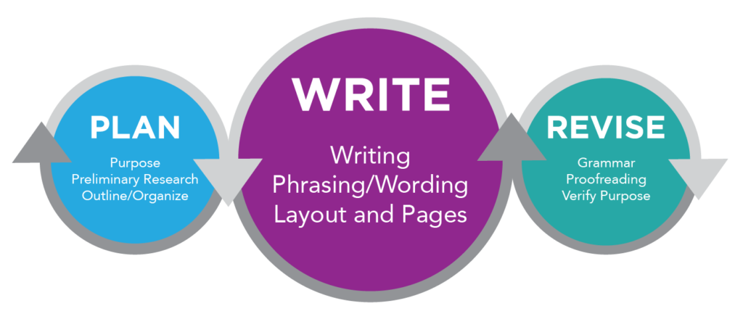
Today is all about…
Writing a report, improving your presentation skills… and your CW2 introduction!

Slide 3
Essay vs Report
An academic essay and an academic report are both forms of academic writing, but they have some differences in terms of their purpose, structure, and style.

Slide 4
Essay vs Report
Purpose
The primary purpose of an academic essay is to argue a particular point of view or to present an original idea or interpretation of a topic. On the other hand, the primary purpose of an academic report is to present factual information on a particular topic, without necessarily arguing a point of view.

Slide 5
Essay vs Report
2. Structure
Academic essays typically have an introduction, body paragraphs, and a conclusion. The introduction sets out the main argument or thesis* of the essay, while the body paragraphs develop and support the thesis through evidence and analysis. The conclusion summarises the main points and restates the thesis. In contrast, academic reports typically have a more structured format, including an executive summary, an introduction, a methodology section, a results section, a discussion section, and a conclusion.
*A thesis is an interpretation of a question or subject, not the subject itself.

Slide 6
Essay vs Report
3. Style
Academic essays often use a more personal tone and may include the author's opinions or interpretations, while academic reports tend to be more objective and impersonal. Academic essays often use more descriptive language, and may include quotations or citations from other sources to support arguments. Academic reports are typically more concise and use technical language.

Slide 7
Essay vs Report
Summary
In summary, the key differences between an academic essay and an academic report are their purpose, structure, and style. Academic essays argue a point of view, have a basic structure, and use a personal tone. Academic reports present factual information, have a more structured format, and use an objective and impersonal tone.

Slide 8
Report Writing
Executive Summary
This is a brief summary of the entire report. It provides an overview of the key findings, conclusions, and recommendations, without going into too much detail. It is often the first thing that readers will see, so it is important to make it clear and concise.

Slide 9
Report Writing
Introduction
This section introduces the topic of the report and provides some background information on why the research* was conducted. It should also include a clear statement of the research question or problem that the report aims to address. The introduction sets the stage for the rest of the report and should capture the reader's interest.
*In the introduction of an academic report, what can research be defined as? More on the next slide…

Slide 10
Report Writing
Research
In the introduction of an academic report, research can be defined broadly as any systematic investigation or inquiry aimed at discovering new knowledge, insights, or understanding. This can include a review of relevant literature, analysis of existing data or information, or original empirical research conducted by the author(s) of the report.
The purpose of research in the introduction is to establish a context for the study and to demonstrate the significance and novelty of the research question or problem that the report aims to address.
Research in the introduction can also involve describing the theoretical framework or conceptual model that underpins the study, as well as outlining the key concepts, variables, or hypotheses that will be examined in the report. This helps to establish the theoretical or analytical basis for the study and provides a roadmap for the reader to understand the subsequent sections of the report.

Slide 11
Report Writing
Methodology
This section describes the methods used to conduct the research, including any data collection techniques, sampling procedures, and statistical analyses. It should provide enough detail so that others could replicate the study if necessary. This section is critical to establishing the validity and reliability of the research.
Discussion: What could be included in the methodology section of an academic report about a particular software project?

Slide 12
Report Writing
Results
This section presents the findings of the research. It typically includes tables, graphs, or other visual aids to help illustrate the data. The results section should be objective and factual, without interpretation or analysis.
Discussion: What could be included in the results section of an academic report about a particular software project?

Slide 13
Report Writing
Discussion
This section interprets the findings presented in the results section. It discusses what the results mean, why they are important, and how they relate to previous research in the field. This section should also address any limitations or weaknesses of the study.

Slide 14
Report Writing
Conclusion
This section summarises the key findings of the study and draws conclusions based on the results and discussion. It should also include recommendations for future research or actions based on the study's findings. The conclusion should be clear and concise and should leave the reader with a clear understanding of the study's significance.

Slide 15
Report Writing
What sections have we missed?
Cover Sheet – you should already know about this, if not, ask.
Contents Page – Sections? Subsections? Page Numbers?
References – CU Scarborough use the APA7 referencing style (American Psychological Association – 7th edition). This is an 'author-date' citation style. This means it uses in-text citations which include the author's name and the resource's publication date, followed by a reference list containing fuller item details at the end of the document.
Appendix - An appendix contains supplementary material that is not an essential part of the text itself but which may be helpful in providing a more comprehensive understanding of the research problem and/or is information which is too cumbersome to be included in the body of the paper.

Slide 16
Referencing APA7
Parenthetical vs. narrative citation
The in-text citation can take two forms: parenthetical and narrative.
Parenthetical citation: According to new research … (Smith, 2020).
Narrative citation: Smith (2020) notes that …

Slide 17
Referencing APA7
Referencing a book (2nd edition, 1 author, no locator)
Author’s Last Name, Initial(s). (Year of publication). Title of book (Edition ed.). Publisher.
Smith, T. (2020). The citation manual for students: A quick guide (2nd ed.). Wiley.

Slide 18
Referencing APA7
Referencing a book (No edition, 2 authors, URL)
Author’s Last Name, Initial(s)., & Author’s Last Name, Initial(s). (Year of publication). Title of book. Publisher. https://URL
Smith, T., & Williams, B. M. (2020). The citation manual for students: A quick guide. Wiley. https://www.ebook.com/citation-manual-students

Slide 19
Referencing APA7
Referencing a journal article (3+ authors, URL)
Author’s Last Name, Initial(s)., Author’s Last Name, Initial(s)., & Author’s Last Name, Initial(s). (Year of publication). Title of article. Title of Journal, Volume(Issue), Pages. https://URL
Andreff, W., Staudohar, P. D., & Streefkerk, R. (2000). The evolving European model of professional sports finance. Journal of Sports Economics, 1(3), 257–276. https://www.journal-of-sports-economics.com/european-model-finance
In-text citation
Parenthetical: (Andreff et al., 2000)
Narrative: Andreff et al. (2000)

Slide 20
Referencing APA7
Video (online (YouTube), channel)
Channel. (Year, Month Day of publication). Title of video [Video]. Website. https://URL
Scribbr. (2020, August 20). Develop a theoretical framework in three steps [Video]. YouTube. https://youtu.be/4y1BAqOnhMM
In-text citation
Parenthetical: (Scribbr, 2020)
Narrative: Scribbr (2020)

Slide 21
Referencing APA7
Webpage (unknown author, full date)
Title of work. (Year, Month Day of publication). Website. https://URL
Whales likely impacted by Great Pacific garbage patch. (2019, April 10). The Ocean Cleanup. https://www.theoceancleanup.com/updates/whales-likely-impacted-by-great-pacific-garbage-patch/
In-text citation
Parenthetical: (Whales, 2019)

Slide 22
First Person?
No. In academic writing the convention is to write in the third person. This means not using personal pronouns (words such as I, me or my), and avoiding referring to yourself or your reader.
If you are producing a piece of reflective writing, or if you tutor has told you that it is acceptable to write in the first person, this is fine. In other circumstances, or if in doubt, always try to write in the third person.

Slide 23
Third Person
Example
You might say to your friend “for my dissertation I will be trying to find the relationship between money spent on advertising and increased consumer spending”. That is fine, you are telling your friend what you are going to do in clear simple English.
However, in your dissertation proposal you would have to put this into third person language. How do you think this should be written?
“This dissertation will explore the relationship between money spent on advertising and increases in consumer spending”.

Slide 24
Third Person
Example
First Person
I think Shakespeare's play Hamlet is about the relationships between family members. I really liked the play, and in some ways the characters reminded me of my own family.
Third Person
Shakespeare's play Hamlet deals with the relationships between family members. In Examining Hamlet, Arnold Latimer describes these relationships as "conflicted" (citation).

Slide 25
Abbreviation?
Is this acceptable in academic writing?
Let’s consider the first theory, which isn’t commonly accepted.
In academic writing it could be written like this:
Let us consider the first theory, which is not commonly accepted.

Slide 26
Abbreviation?
How should these be written?
I’m
isn’t
let’s
she’s
you’ve
I am
is not
let us
she is
you have

Slide 27
Brevity
Brevity means shortness or conciseness. If you give a report on agriculture in the northern hemisphere in three minutes, you have done it with incredible brevity.
A good academic submission has a good balance between brevity and detail.

Slide 28
Brevity
Five Principles of Brevity
1. Delete words that mean little or nothing. Sometimes we use words that are meaningless. Here are a few common examples:
kind of
actually
really
particular
certain
various
virtually
individual
basically
generally
given
practically

Slide 29
Brevity
Five Principles of Brevity
2. Delete words that repeat the meaning of other words. Repetition adds nothing to a text. To avoid redundancy, do not use two words where one will do. The following ideas could each be expressed in one word:
full and complete
hopes and dreams
any and all
true and accurate
each and every
basic and fundamental
first and foremost
various and sundry

Slide 30
Brevity
Five Principles of Brevity
3. Delete words implied by other words. These redundancies are more difficult to identify because they come in many forms.
Redundant modifiers: These describe a word that is already clearly understood, such as “past history” and “unexpected surprise.”
Redundant categories: When an item is placed in a category that we know it belongs to, such as “red in colour” and “shiny in appearance.”
General implications: When sentences are too full of implied redundancy, it is sometimes better to just start over. “Imagine someone trying to learn the rules for playing the game of chess” becomes “Imagine learning the rules of chess.”

Slide 31
Brevity
Five Principles of Brevity
4. Replace a phrase with a word. Sometimes we describe a verb instead of using it, for example: “I carefully read over what I had written to improve wording and catch errors in spelling and punctuation” could read “I edited.”
Other times we just use a common phrase where a shorter one would work:
in the event that = if
concerning the matter of = about
the reason for = why

Slide 32
Brevity
Five Principles of Brevity
5. Change negatives to affirmatives. Writing what did not happen, takes more words than writing what happened. It can also be confusing. Any word preceded by a not (not different, not the same, not notice) could be replaced by a shorter affirmative (similar, different, overlook).

Slide 33
Brevity
Quiz
My brother and I both play cricket
My brother and I play cricket
The reason why she did not come was because she was sick
The reason she did not come was because she was sick
The dog chased after the rabbit
The dog chased the rabbit

Slide 34
Brevity
Quiz
In my opinion, I think you are wrong
I think you are wrong
The two twins are good swimmers
The twins are good swimmers
The planet was visible to the eye
The planet was visible

Slide 35
Using an Appendix
Using an appendix in an academic report can be beneficial for several reasons:
In-depth Information: Appendices allow you to include supplementary material that is too detailed or extensive to be included in the main body of the report. This additional information can provide readers with a more comprehensive understanding of your research without overwhelming the main text.

Slide 36
Using an Appendix
Clarity and Conciseness: Including detailed data, lengthy tables, or complex charts in the main body of the report can make it dense and difficult to read. Placing such material in an appendix ensures that the main text remains focused, clear, and concise, while interested readers can refer to the appendix for more detailed information.
Readability: Appendices help maintain the flow and readability of the main text. Readers who are primarily interested in the core content of the report can focus on the main body, while those seeking additional details can turn to the appendix.

Slide 37
Using an Appendix
Reference and Verification: Appendices are useful for providing documentation or evidence supporting your findings. This can include raw data, survey instruments, coding scripts, or any other materials that may be important for others to verify or replicate your research.
Avoiding Distractions: Including too much detail in the main text can distract readers from the main points of your argument or research. Appendices allow you to strike a balance between providing comprehensive information and maintaining the flow of your narrative.

Slide 38
Using an Appendix
Meeting Guidelines and Requirements: In some academic or publication guidelines, certain types of material may be required to be placed in an appendix. Following these guidelines ensures that your report adheres to the accepted standards in your field.
Facilitating Review: For peer reviewers, having supplementary material in the appendix can facilitate a thorough review process. Reviewers can delve into the details, if necessary, without interrupting the flow of the main text.
Remember to clearly label and reference your appendices in the main body of your report so that readers can easily locate and understand the relevance of the additional material.

Slide 39
Assessment – Coursework 2
402IT
Information Security
Weighting – 60%
Due date: 15th December 2023 18:00
Your assessment contains 2 tasks:
Individual Presentation – 60 marks
Briefing Report – 40 marks

Slide 40
Assessment – Coursework 2
Introduction: As the Security Consultant for Greenwood Financial Services in the case study in CW1, your primary objective is to analyse the information systems and infrastructure, identify security issues and vulnerabilities, and propose detailed mitigation strategies. This assignment builds upon the previous assignment's risk assessment and expands on the implementation of necessary remediation measures to address the identified risks.

Slide 41
Assessment – Coursework 2
Task-1: Individual Presentation (60 Marks)
Prepare an individual presentation for the Information Security Officer to communicate the findings from the risk assessment conducted in Assignment 1. The presentation should include the following elements:
Executive Summary: Provide a concise overview of the organisation's current security posture, emphasizing the most critical risks and their potential impact on the business.
Identified Security Issues: Present the key security issues and vulnerabilities discovered during the risk assessment, explaining their potential consequences for the organisation.
Mitigation Strategies: Propose detailed mitigation strategies and controls to address each identified risk. Explain the rationale behind each strategy and how it aligns with industry best practices and standards.

Slide 42
Assessment – Coursework 2
Task-2: Briefing Report (40 Marks)
Produce a detailed briefing report that complements your individual presentation. The report should include the following sections:
Introduction: Provide an overview of the organisation, its information systems, and the purpose of the report.
Methodology: Describe the methodology used to conduct the risk assessment, including the techniques, tools, and frameworks employed.
Risk Assessment Findings: Summarise the key findings from the risk assessment, focusing on the identified security issues and vulnerabilities.
Mitigation Strategies: Present detailed mitigation strategies for each identified risk, including technical, administrative, and physical controls. Support your recommendations with relevant industry standards and best practices.
Conclusion: Summarise the key points discussed in the report and emphasize the importance of implementing the proposed mitigation strategies to enhance the organisation's information security posture.

Slide 43
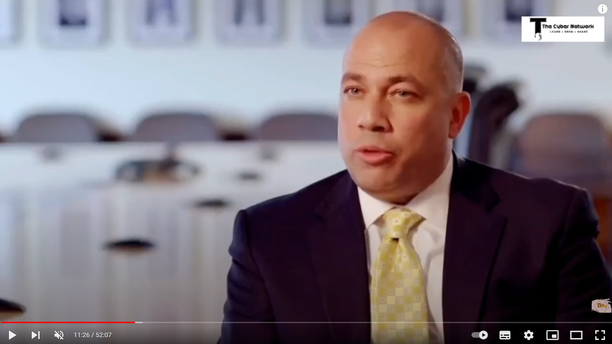
Presentation Skills Task
https://youtu.be/nsKIADw7TEM?si=Iqy-Z-v-n0PhyLO8

Slide 44
Presentation Skills Task
As your assessment is an 'individual presentation';
Prepare a 5-minute presentation, on the video you have just watched.
Use supplementary documentation (PowerPoint slides etc).
1. Introduction (1 minute):
Start with an attention-grabbing statement or question related to hacking to pique the audience's interest.
Briefly introduce the purpose of your presentation: to discuss key aspects of a hacking video and its implications.
2. Overview of your findings (1 minute):
Provide a brief summary of the video you watched.
Highlight key elements such as the methods used, targets, and potential impact.
If the video is complex, focus on one or two specific aspects for in-depth analysis.
3. Hacking Techniques (1 minute):
Discuss the hacking techniques demonstrated in the video.
Explain any terms or concepts that may be unfamiliar to the audience. Remember, you won't always be delivering to your fellow classmates.
Keep the explanation concise and accessible, avoiding overly technical language.

Slide 45
Presentation Skills Task
4. Implications and Risks (1 minute):
Address the potential implications and risks associated with the hacking techniques shown in the video.
Discuss how these techniques can be harmful and the types of information or systems that may be at risk.
Connect the content to broader cyber security concerns and the importance of awareness.
5. Mitigation and Prevention (1 minute):
Briefly outline possible measures to mitigate the risks demonstrated in the video.
Discuss general cyber security best practices and how individuals or organisations can protect themselves against similar threats.
Encourage the audience to be vigilant and proactive in enhancing their digital security.
6. Conclusion (30 seconds):
Summarise the key points of your presentation.
End with a thought-provoking statement or call to action to encourage the audience to reflect on the importance of cybersecurity.
You have 1 hour to prepare!

